Slide 1

Land Type Classification Using Sentinel-2 Satellite Images
Participants:
Mohamed Abdel Azim El Rakaybi
Ahmed Yehya
Ahmed Mohamed Ghallab
Salma Naser
Aya Mohamed
DEPI Round3
AI & Data Analysis Project

Slide 2
Contents
Introduction
EDA
ML Models
Visualization
WEB UI
Potential future work

Slide 3
Introduction
Sentinel-2 provides free multispectral images that are ideal for land use classification. The objective of this project is to develop a DNN model that accurately classifies land types, aiding in various applications such as urban planning, environmental monitoring, and resource management.
This project focuses on classifying different land types—such as agricultural areas, forests, urban regions, water bodies, and roads—using the EuroSAT dataset, which consists of Sentinel-2 satellite imagery.
This Project analyzed the dataset to know its structure and features, then developed ML models ascending from kmeans clustering to Random forest classification to XGBoosting to CNN ML models.
Used total mean sampling and random pixel sampling

Slide 4
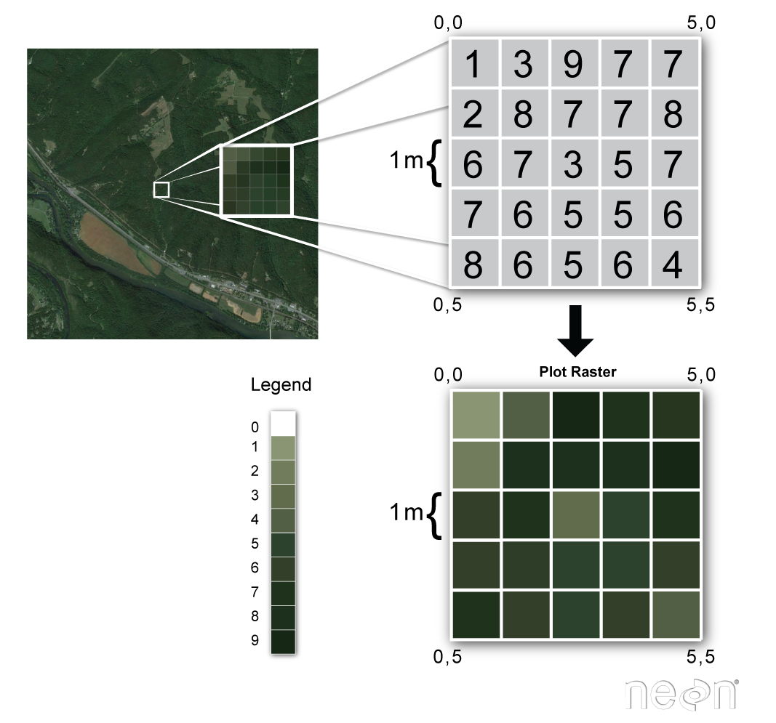
EDA
Used rasterio to read dataset Tiff files.
Dataset Overview
Source: EuroSAT Dataset (Kaggle)
Origin: Sentinel-2 imagery captured by ESA.
Image Format: RGB (JPEG) and optionally 13-band TIFF.
Resolution: 10–60 m (resampled to 64×64 pixels).
Classes (10):
Annual Crop
Forest
Herbaceous Vegetation
Highway
Industrial
Pasture
Permanent Crop
Residential
River
Sea/Lake

Slide 5
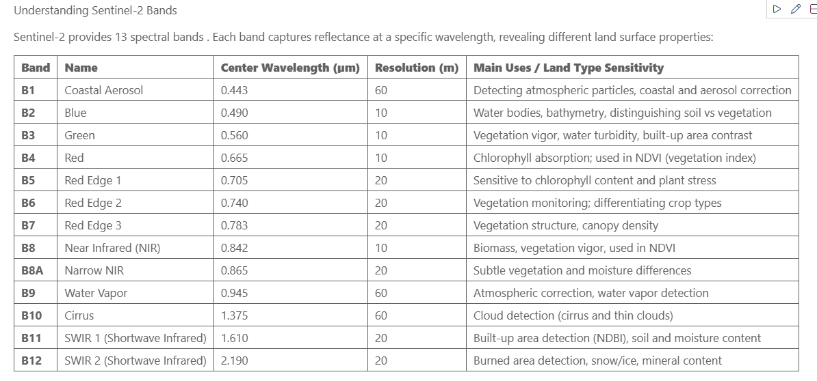

Slide 6
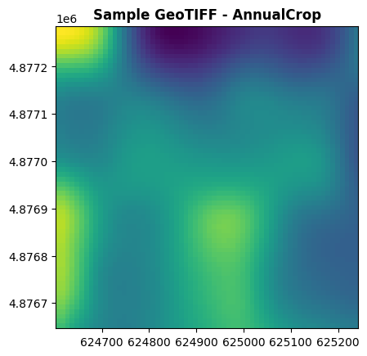
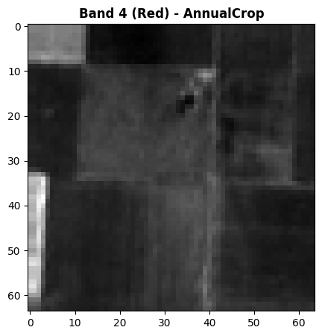
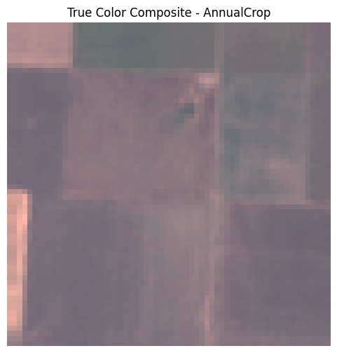
Visualize sample image with different bands

Slide 7
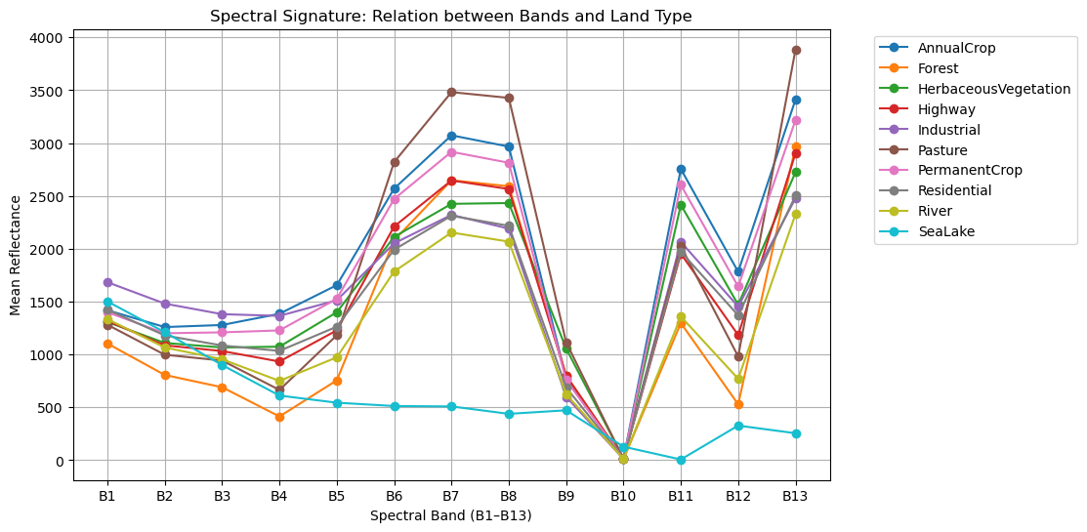

Slide 8
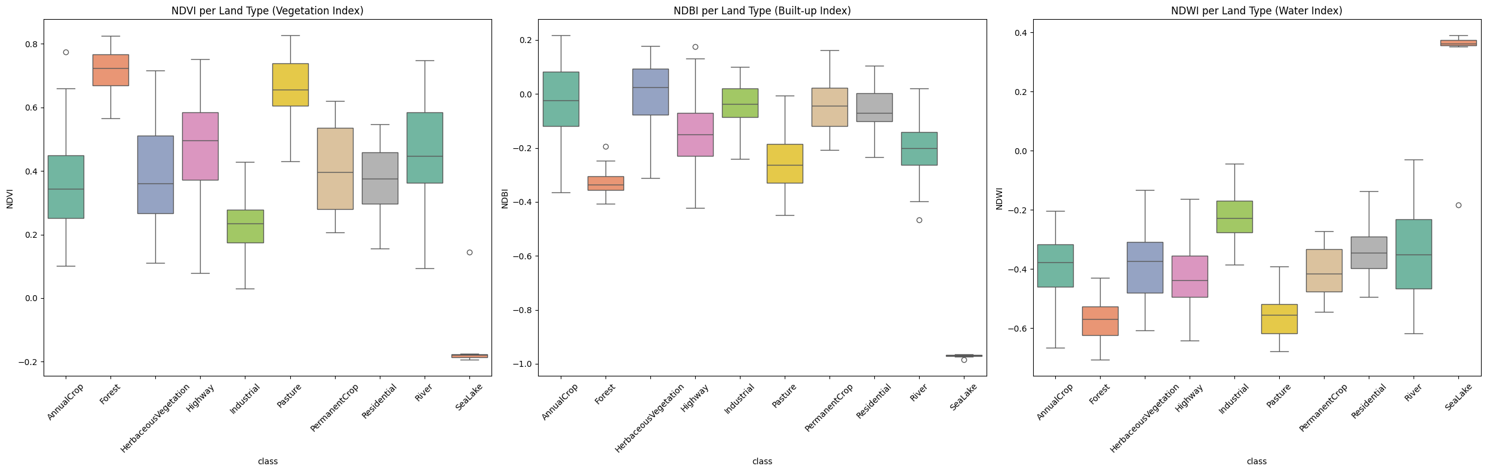
Spectral Indices (NDVI, NDBI, NDWI) — Vegetation, Urban, Water

Slide 9
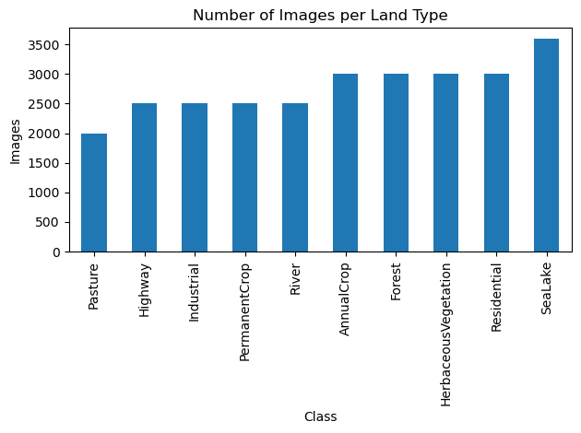
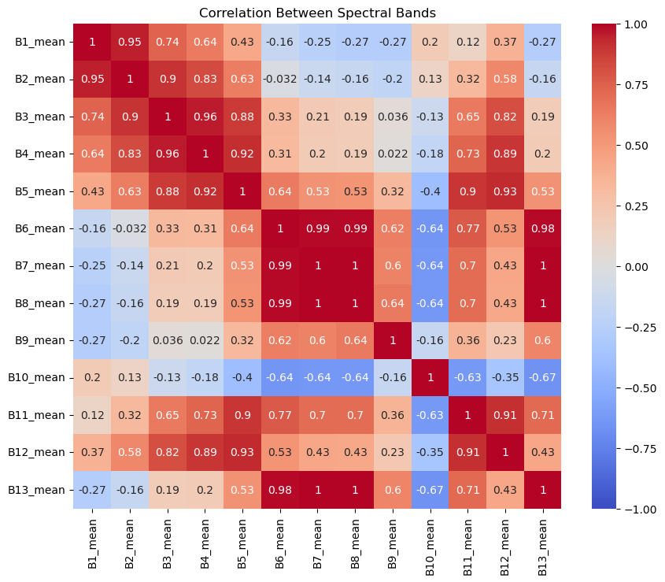
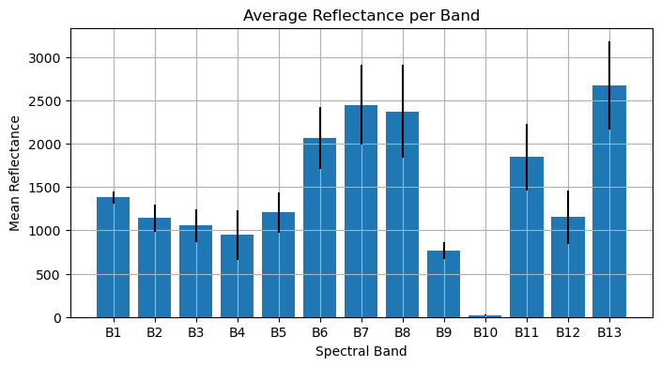

Slide 10
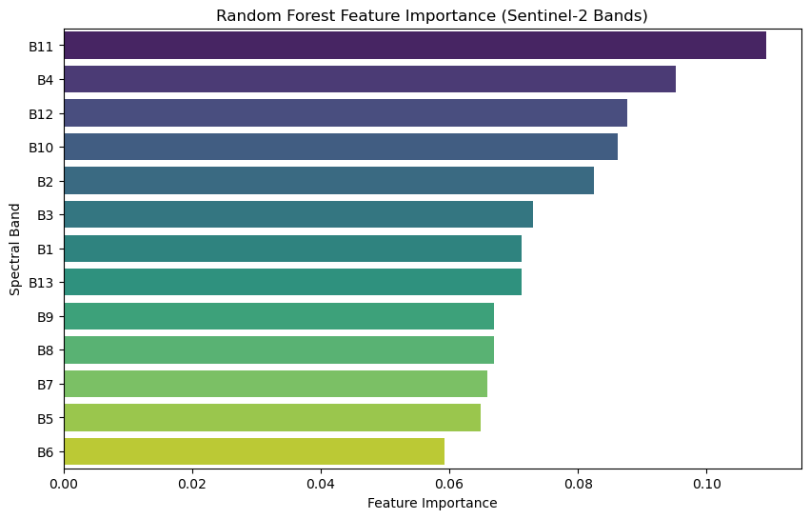
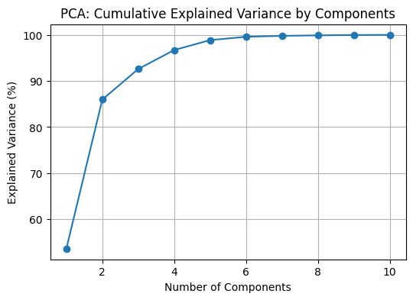
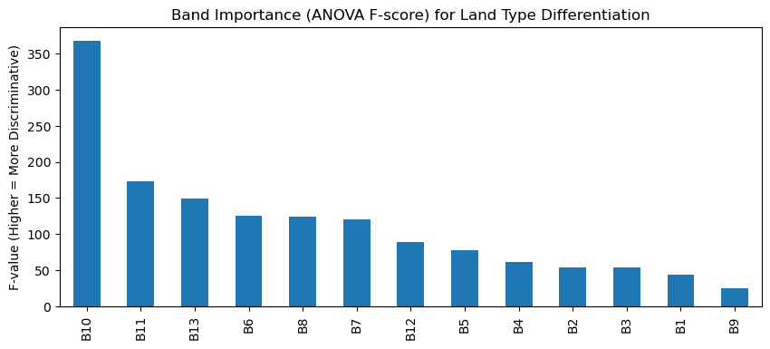
Feature Importance

Slide 11
ML Models Classification
Used Mean value for each band to represent each band from 1 to 13 and added NDVI, NDBI and NDWI
Used to supervised modeling types (RF classification modelling and XGBoosting modelling)
Tried to use Pixel sampling but took long time and generated big models were hard to upload and accuracy similar to mean sampling
Used CNN model for deep Machine learning which gives high accuracy but takes long time for training and testing.

Slide 12
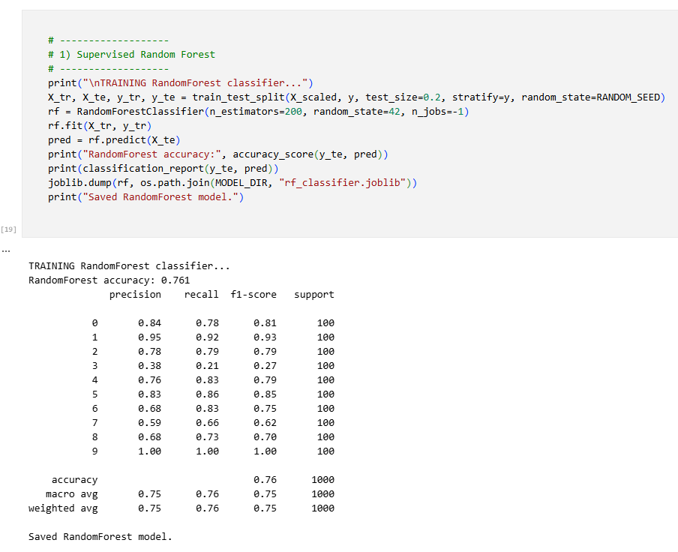
RandomForest Mean Sampling Model

Slide 13
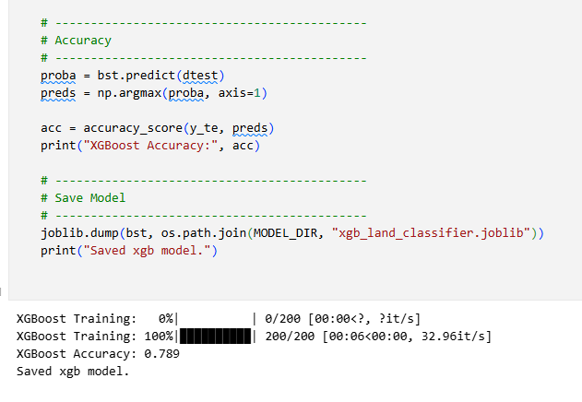
XGBoosting Mean Sampling Model

Slide 14
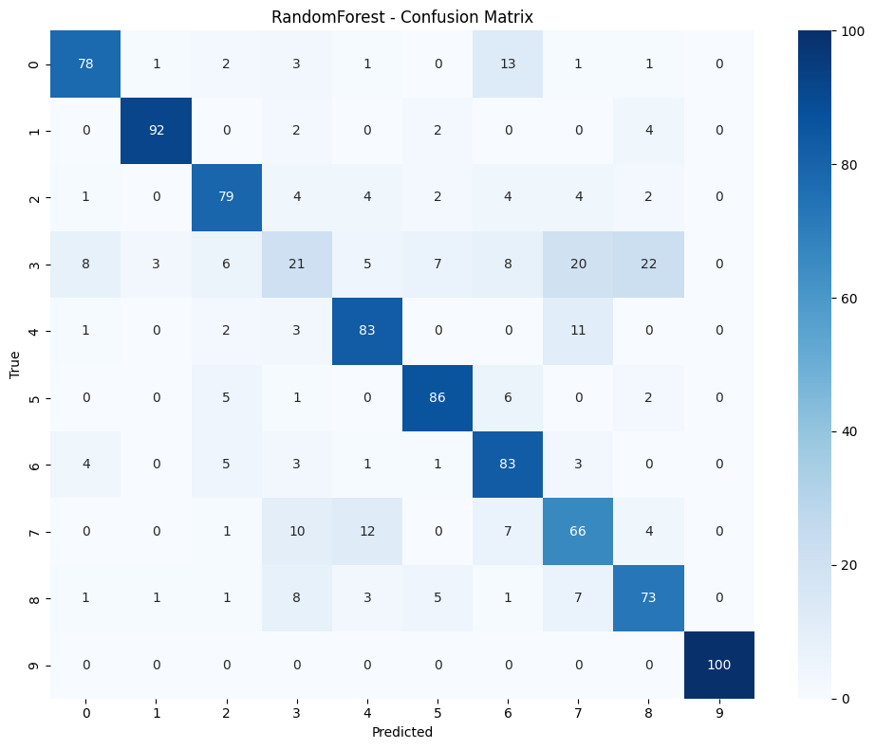

Visualization
{0: 'AnnualCrop', 1: 'Forest', 2: 'HerbaceousVegetation', 3: 'Highway', 4: 'Industrial', 5: 'Pasture', 6: 'PermanentCrop', 7: 'Residential', 8: 'River', 9: 'SeaLake'}

Slide 15
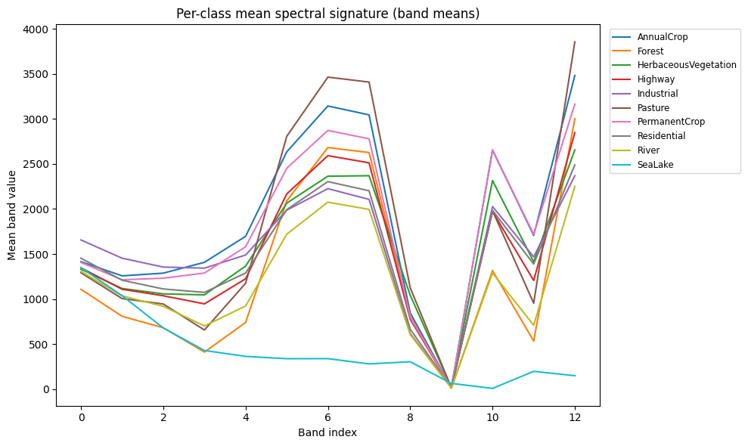
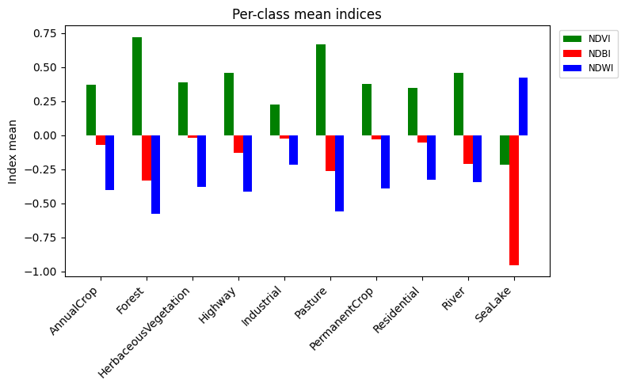
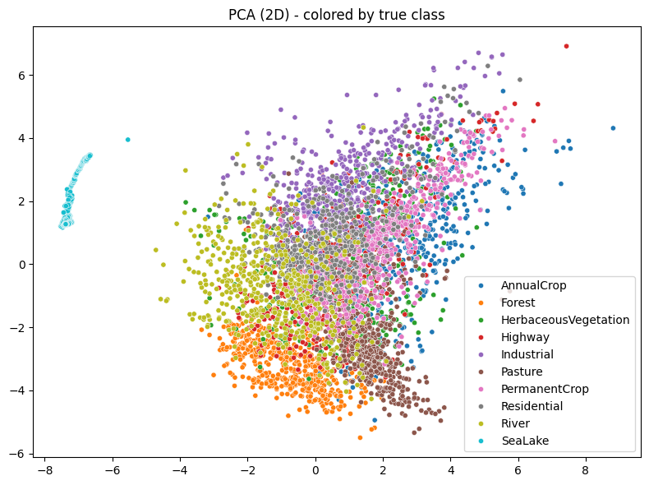
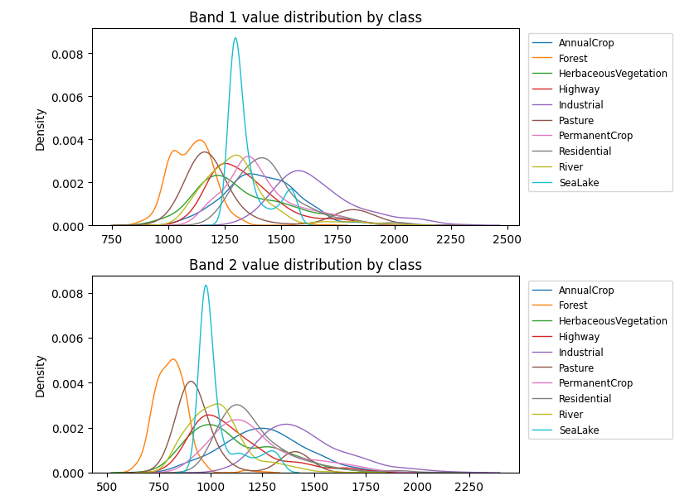

Slide 16
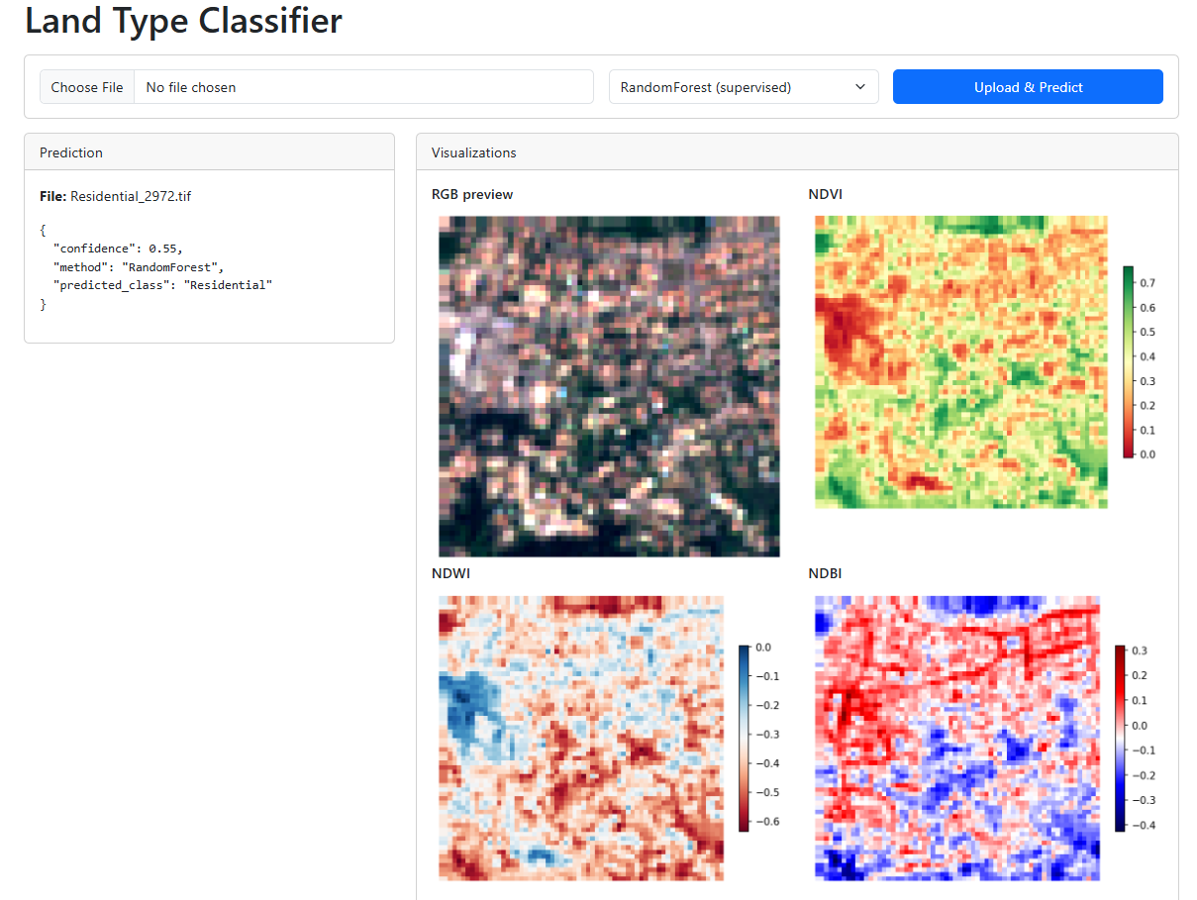
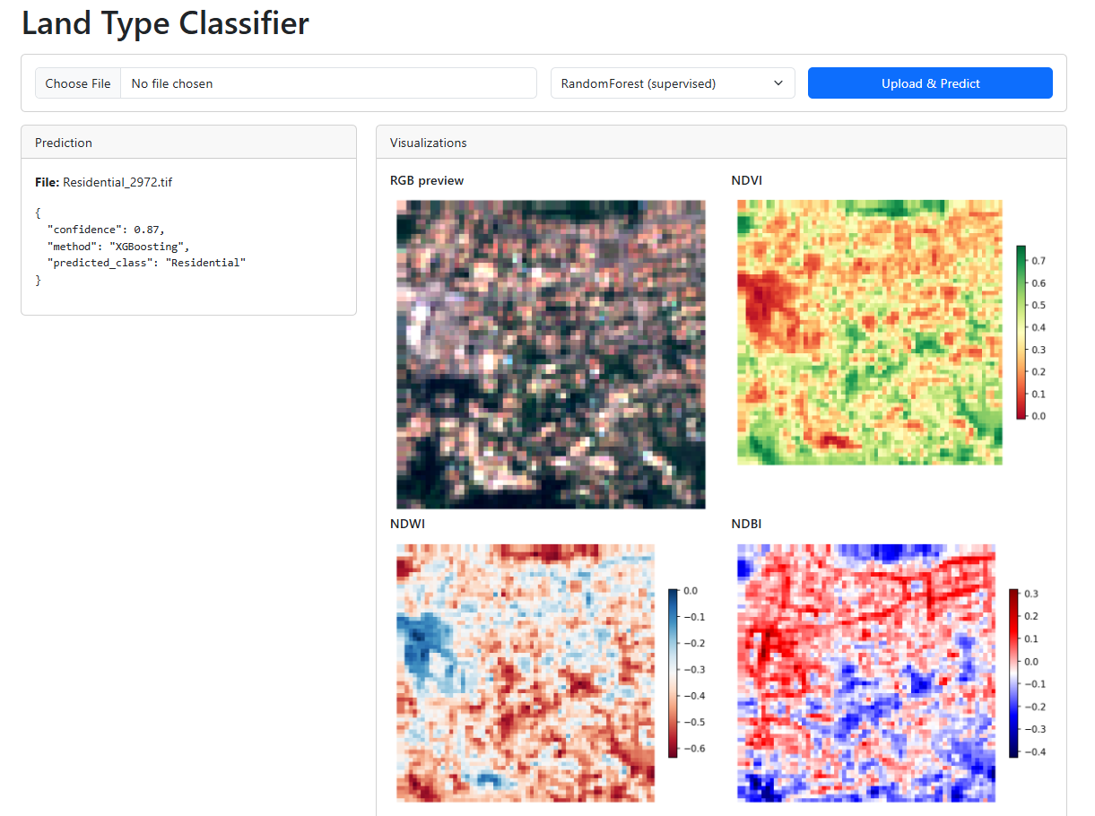
WEB UI

Slide 17
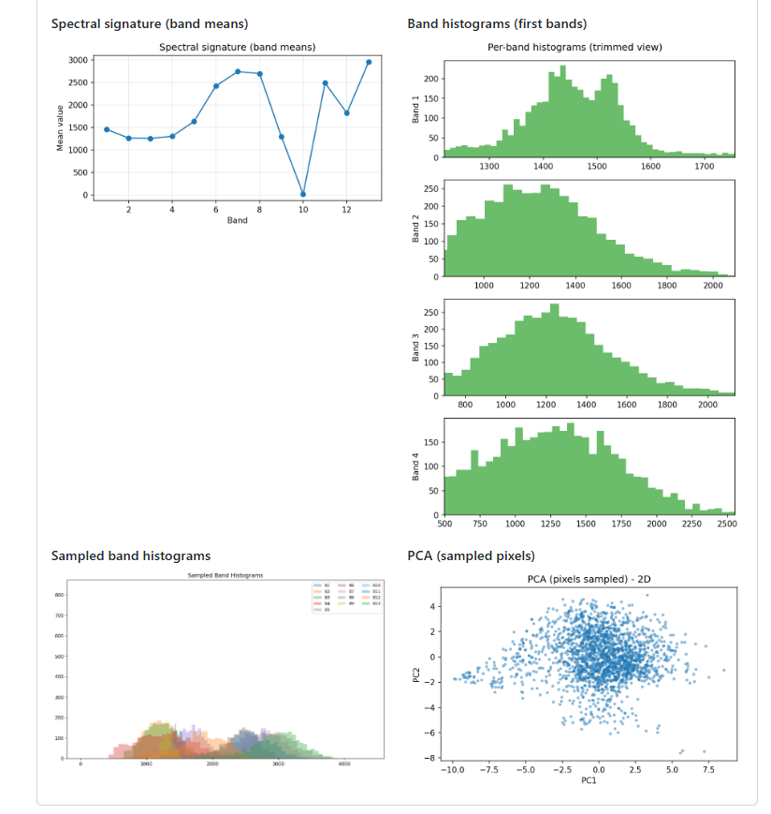
WEB UI

Slide 18
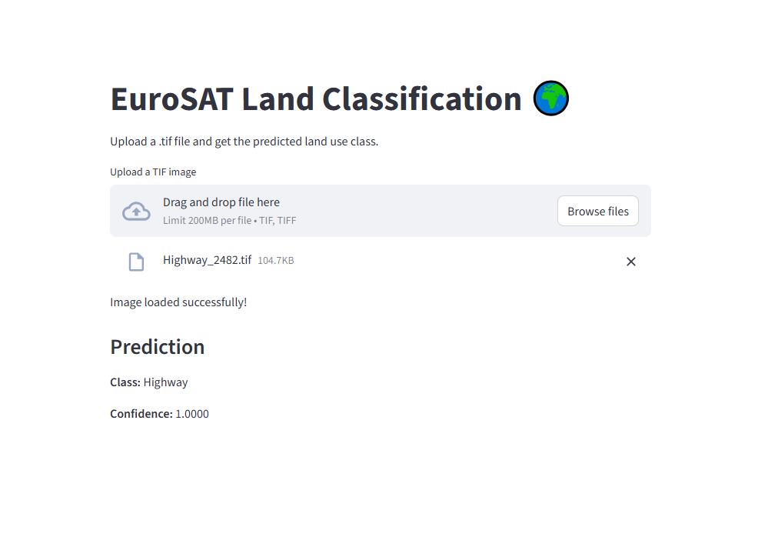
CNN Model

Slide 19
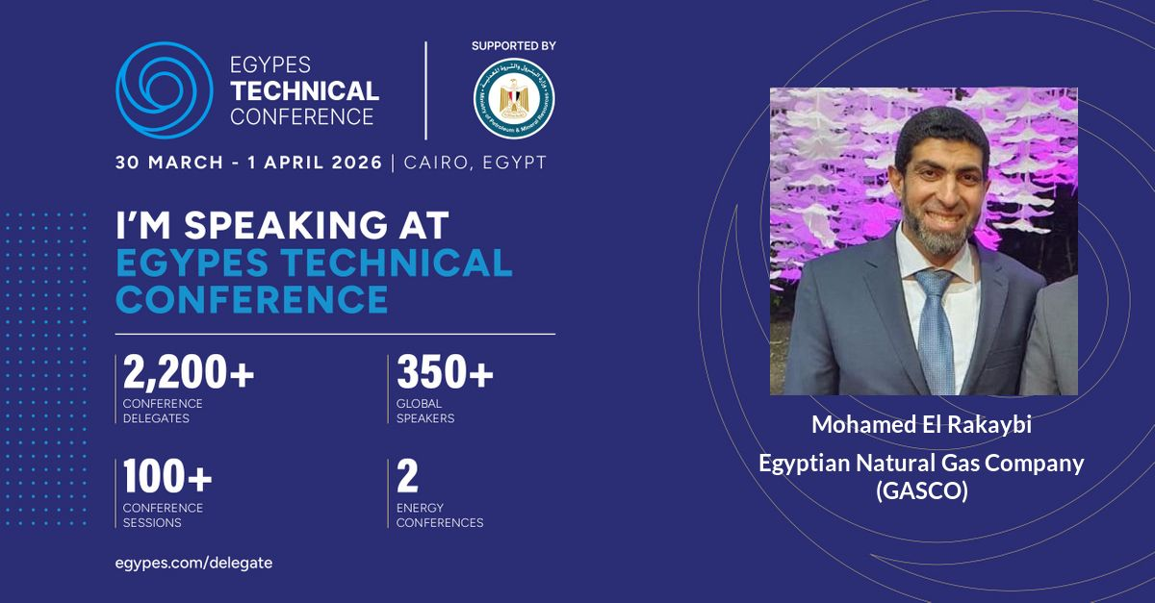
Potential future work
Integrating AI with high resolution satellite imaging can be used to detect civil violations from buildings near natural gas network pipelines in violation of law.
This can protect the national gas grid in Egypt.
This idea will be proposed in the next EGYPES conference in 2026.
This proposal will include prototype to demonstrate the principle idea.

Slide 20
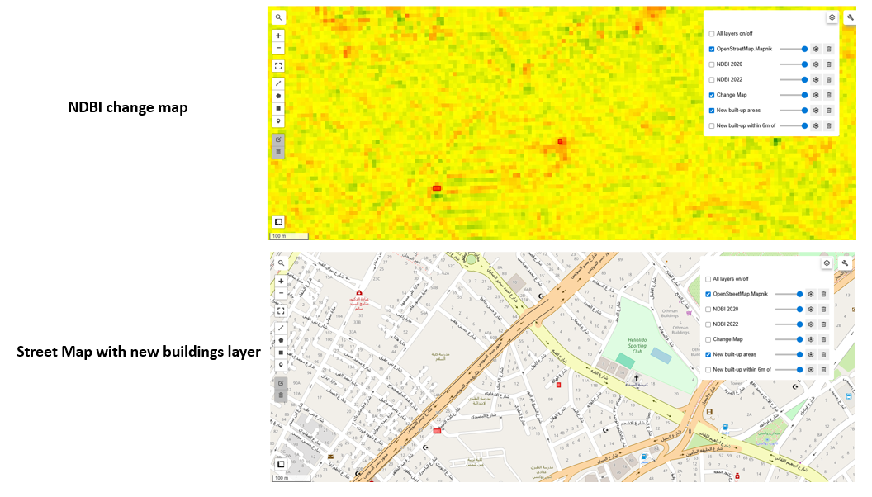

Slide 21
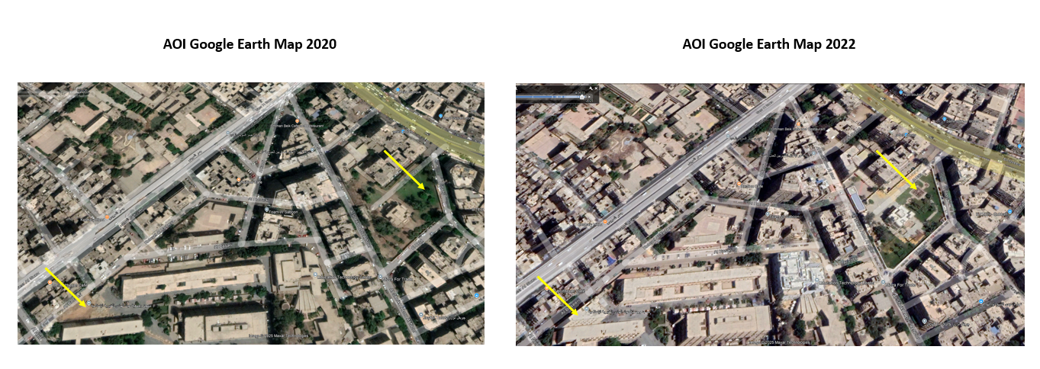
Detected changes

Slide 22
Thank You

